Slide 1

Software Project Management
Dr. Sumaira Nazir
Department of Software Engineering
National University of Modern Languages, Islamabad

Slide 2
Developing a Project Charter

Slide 3
Project Charter
Information include
The project’s title and date of authorization
The project manager’s name and contact information
A summary schedule, including the planned start and finish dates; if a summary milestone schedule is available, it should also be included or referenced
A summary of the project’s budget or reference to budgetary documents

Slide 4
Project Charter
Information include
brief description of the project objectives, including the business need or other justification for authorizing the project
Project success criteria, including project approval requirements and who signs off on the project

Slide 5
Project Charter
Information include
A summary of the planned approach for managing the project, which should describe stakeholder needs and expectations, important assumptions, and constraints, and should refer to related documents, such as a communications management plan, as available
A roles and responsibilities matrix
A sign-off section for signatures of key project stakeholders
A comments section in which stakeholders can provide important comments related to the project

Slide 6
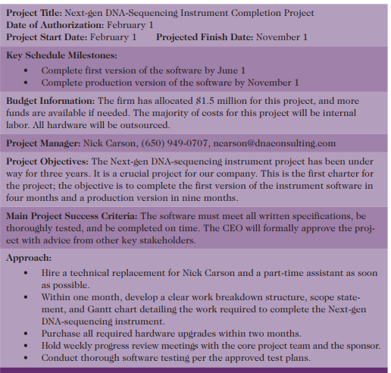

Slide 7
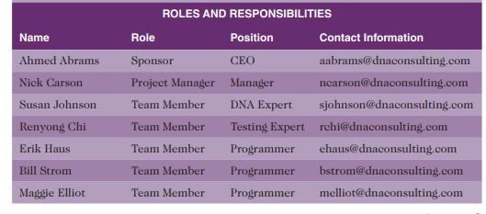
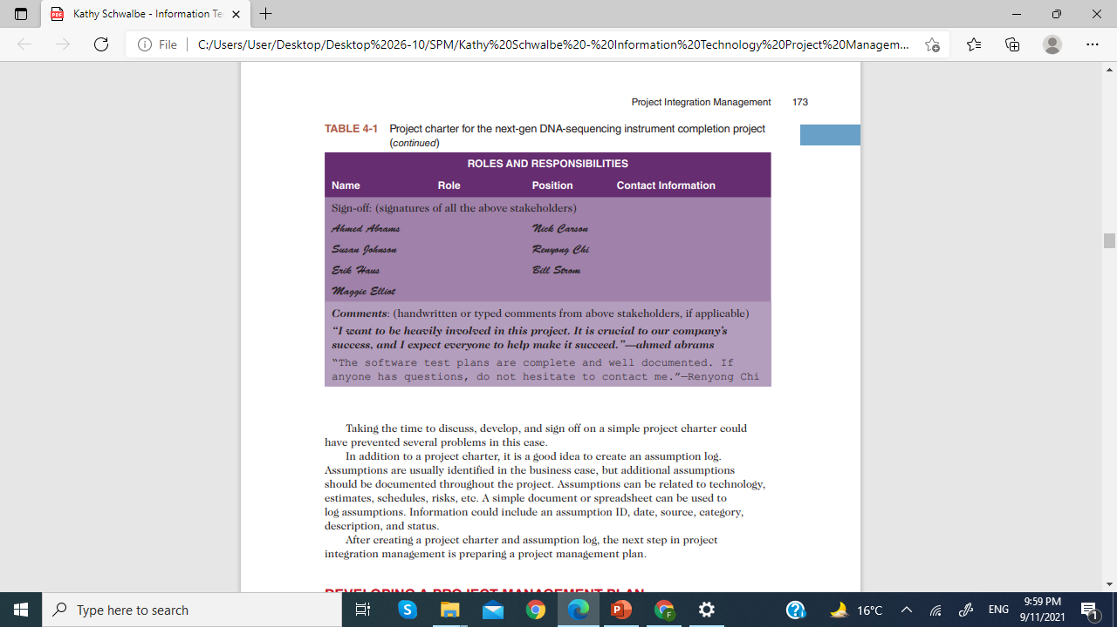

Slide 8
Activity
You are the project manager leading a digital transformation initiative for a mid-sized retail company aiming to enhance its online presence and streamline its e-commerce operations. The project, named "Digital Retail Revolution," has a budget of $500,000 allocated for implementing new e-commerce platforms, upgrading IT infrastructure, and launching targeted digital marketing campaigns. As the project manager, your primary objective is to modernize the company's digital infrastructure, improve customer experience, and increase online sales by 30% within the next fiscal year.
The project charter must be designed to outline the scope, objectives, budget allocation, project manager's responsibilities, and critical deadlines, including completing the platform integration within six months and launching the marketing campaigns within nine months.

Slide 9
Project Scope Management

Slide 10
Project Scope Management
Scope refers to all the work involved in creating the products of the project and the processes used to create them.
Deliverable is a product created as part of a project.
Deliverables can be product related, such as a piece of hardware or software, or process related, such as a planning document or meeting minutes.
Project stakeholders must agree what the products of the project are and, to some extent, how they should be produced to define all of the deliverables

Slide 11
Project Scope Management
Project scope management includes
The processes involved in defining and controlling what work is or is not included in a project.
It ensures that the project team and stakeholders have the same understanding of what products the project will produce and what processes the project team will use to produce them

Slide 12
Project Scope Management
Six main processes are involved in project scope management:
Planning scope management
Collecting requirements
Defining scope
Creating the WBS
Validating scope
Controlling scope

Slide 13
Project Scope Management
Six main processes are involved in project scope management:
Planning scope management involves determining how the project’s scope and requirements will be managed.
Collecting requirements involves defining and documenting the features and functions of the products as well as the processes used for creating them.
Defining scope involves reviewing the scope management plan, project charter, requirements documents, and organizational process assets to create a scope statement, adding more information as requirements are developed and change requests are approved.

Slide 14
Project Scope Management
4. Creating the WBS involves subdividing the major project deliverables into smaller, more manageable components.
5. Validating scope involves formalizing acceptance of the project deliverables. Key project stakeholders, such as the customer and sponsor for the project, inspect and then formally accept the deliverables during this process. If the deliverables are not acceptable, the customer or sponsor usually requests changes.

Slide 15
Project Scope Management
Six main processes are involved in project scope management:
6. Controlling scope involves controlling changes to project scope throughout the life of the project—a challenge on many IT projects. Scope changes often influence the team’s ability to meet project time and cost goals, so project managers must carefully weigh the costs and benefits of scope changes

Slide 16
Project Scope Management
Work break down structure
A work breakdown structure (WBS) is a deliverable-oriented grouping of the work involved in a project that defines its total scope
is a hierarchical outline of the tasks required to complete a project

Slide 17
Project Scope Management
Work break down structure
Because most projects involve many people and many different deliverables, it is important to organize and divide the work into logical parts based on how the work will be performed.
WBS is a foundation document in project management because it provides the basis for planning and managing project schedules, costs, resources, and changes.

Slide 18
Project Scope Management
Work break down structure
Because the WBS defines the total scope of the project, some project management experts believe that work should not be done on a project if it is not included in the WBS.
Therefore, it is crucial to develop a complete WBS.

Slide 19
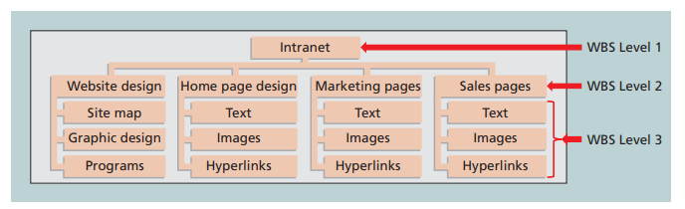

Slide 20
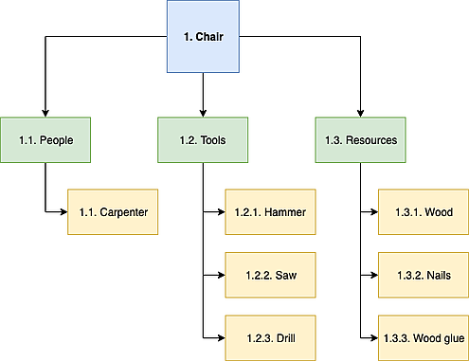
WBS

Slide 21
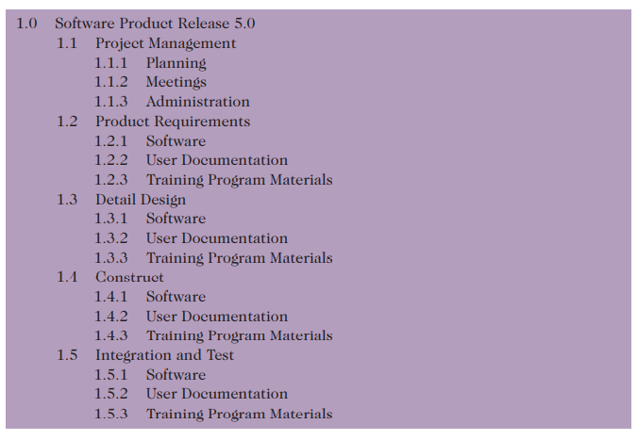

Slide 22
Project Scope Management
WBS-Dictionary
A WBS dictionary is a document that provides detailed information about each WBS item.
The term dictionary should not be confused with defining terms or acronyms in this case; such definitions belong in a glossary that would be included elsewhere in the project documentation. Instead, the WBS dictionary is a definition of the work involved in the task.

Slide 23
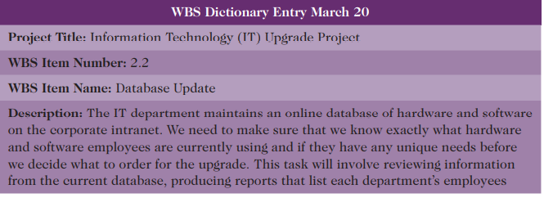
Project Scope Management
WBS-Dictionary

